Slide 1
World Immunization Progress
Lisa Cannon, Shilpa Muralidhar, Brian Labelle

Slide 2
Introduction
What is vaccination?
What does it do?
Why is it important?

Slide 3
Motivation
My background in vaccine research
Availability of datasets for our analyses that are:
Large
Reliable
Clean

Slide 4
Datasets
14 vaccines data from UNICEF
BCG, RCV, MCV1, 2, PCV, DTP1, 3 -prevents Tuberculosis, Rubella, Measles, Pneumonia, Diphtheria
Hi-B - Meningitis
ROTAC- prevents intestinal infections
Hepb3, Hep-bb - prevents hepatitis
IPV, POL3 – prevents polio disease
YFV- prevents yellow fever

Slide 5
Datasets
UNICEF regions –
ECAR – Europe and Central Asia
EAPR– East Asia and Pacific
ESAR - East, South Africa
MENA- Middle East and North Africa
ROSA - South Asia
WCAR- West, Central Africa
LACR - Latin America , Caribbean
CEECIS- Russia, Eastern Europe
Industrialized - Scandinavia, Western Europe, USA, Japan, Australia, Israel
Population data from World Bank

Slide 6
Goals
Which countries are better vaccinated than others?
What are the causes of variation?
Does vaccination decrease infant mortality?
Does it increase life expectancy?

Slide 7
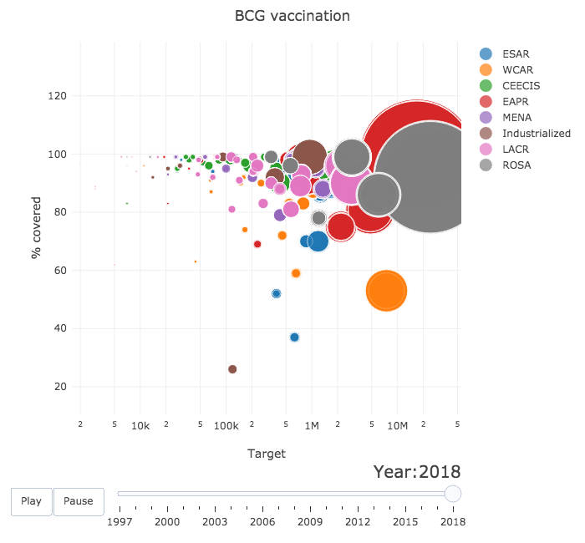
Who fares better?
India
China

Slide 8
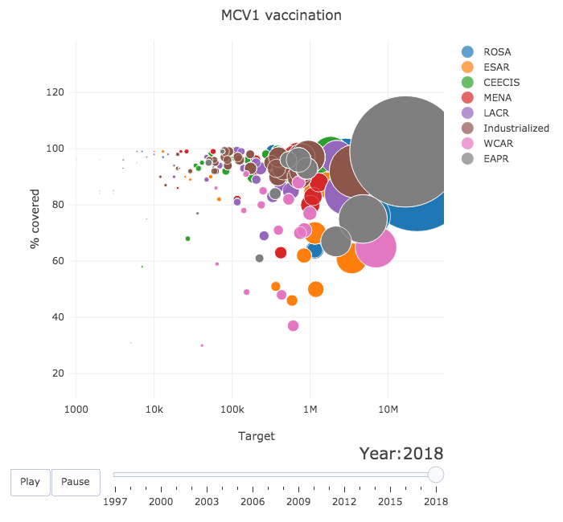
Who fares better ?
India
China

Slide 9
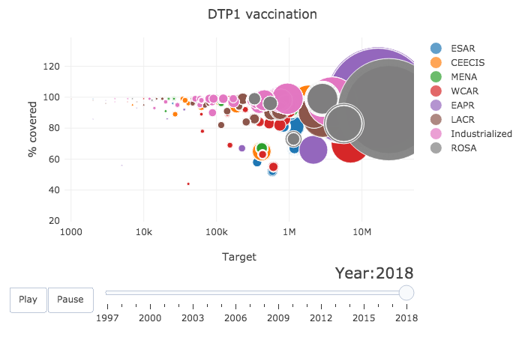
Who fares better ?
India
China

Slide 10
Insights
Collective trend towards complete vaccination
Global success will be achieved when at least some frictions are removed:
Economic and Political instability
Infrastructure
Removal of poverty
Mis-information

Slide 11
Analysis
Let’s check out our website!
https://muracan2.herokuapp.com/

Slide 12
Conclusion
In general, a give vaccination has a positive relationship with life expectancy and a negative relationship with infant mortality.
When data is complete, linear regression fits look promising but the assumption of equal variance is violated.
More questions are raised… More analysis is needed.

Slide 13
What’s next for analysis?
Compare vaccination coverage geographically to see if regional trends exist.
Regression analysis: Automate the process of determining a variance stabilizing transformation when needed.
Regression analysis: Automate outlier detection.
Look at other measures of health and wellbeing.
Incorporate other factors that influence health and conduct a multiple linear regression analysis.

Slide 14
That’s not all!
Back to the website
https://muracan2.herokuapp.com/

Slide 15


UI marucan2
PostGres muracan
Trend muracantrend
Mortality muracaninfant
Life Expect muracanlif

Slide 16
Questions?

